Slide 1
Spring boot

Slide 2
Spring Boot makes it easy to create stand-alone, production-grade Spring based Applications. It’s a Java-based framework used to create a microservice ( microservice is defined as the small services that work together. The microservice defines an approach to the architecture that divides an application into a pool of loosely coupled services that implement business requirements).
Now let’s understand the definition of Spring Boot in simple words Spring Boot word is made up of 2 words Spring and Boot the first part of spring represents spring framework (The framework that let you write enterprise java applications) now second part boot that is bootstrap so combining both words Spring Boot means something that lets you bootstrap a spring application from the scratch.

Slide 3
Advantages:
The primary advantage of spring-boot is enabling auto-configuration for the project. This reduces the burden on programmers and saves a lot of time.
It makes use of annotations which are very simple and replace the typical XML based configuration setup in spring MVC.
Provides an embedded servlet container and helps in easily bootstrapping (quick run) the application that is production-ready.
It enables creation of fat Jar for spring applications which has all the dependencies present in it and hence you can directly run it.
Microservices architecture can be built effectively with the spring-boot framework and it also provides concepts such as spring-boot-starter for the dependency management.

Slide 4
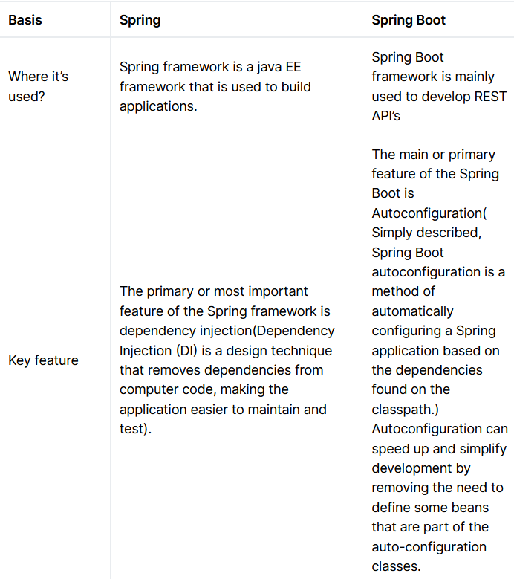

Slide 5
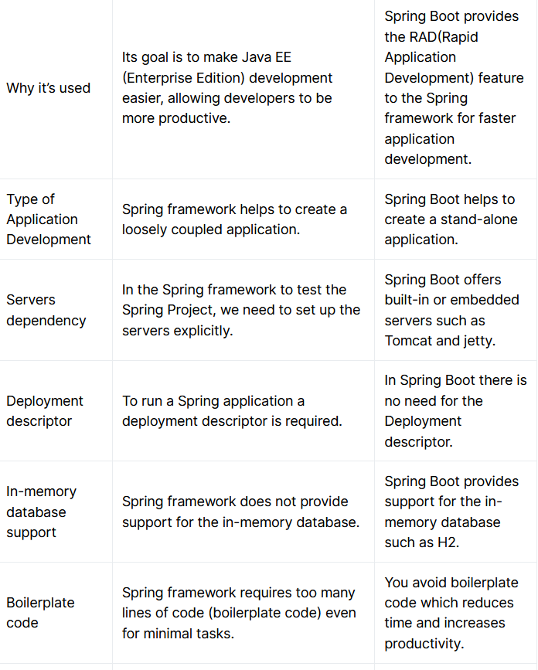

Slide 6
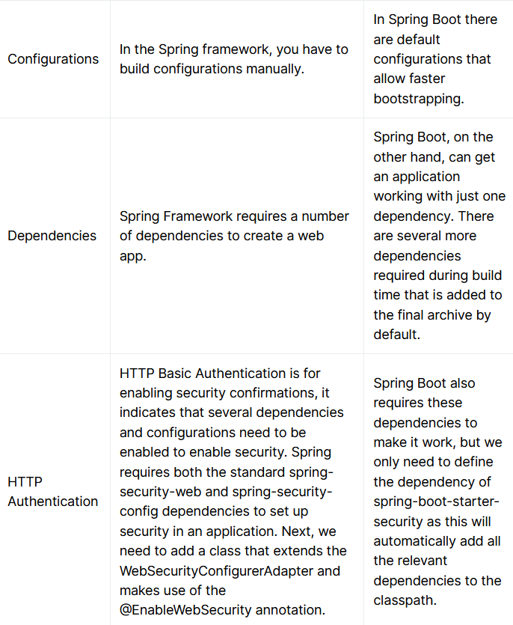

Slide 7
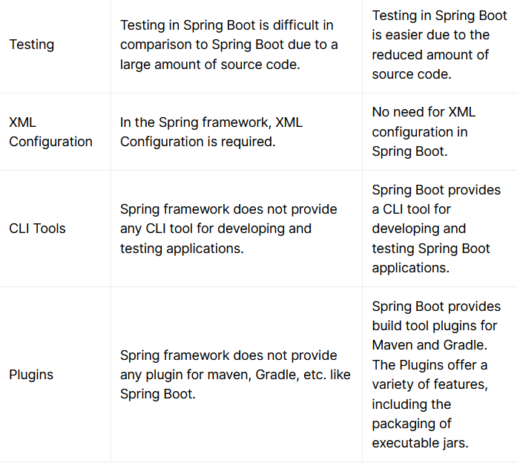

Slide 8
Classpath Dependencies:
Setting up a project requires a lot of external libraries (core Java and other related frameworks).Spring-boot enables auto-configuration which is dependent on the available JARs in the classpath.
spring-boot-starter helps in managing all the dependencies effectively unlike spring-MVC where there is no concept of starters.

Slide 9
What is spring-boot-starter?
Starters enable effective dependency management for your spring based project. For example, if we want to use hibernate as the ORM tool, we need the hibernate maven script (To be included in pom.xml file of the project) as follows.
<dependency>
<groupId>org.hibernate</groupId>
<artifactId>hibernate-core</artifactId>
<version>5.4.2.Final</version>
</dependency>

Slide 10
Spring-boot provides starters such as spring-boot-starter-data-jpa which provides the above mentioned hibernate dependencies as well as the spring-data-jpa dependencies when included in the maven project.
In short, starters are the composition of multiple dependencies which are resolved easily and reduces the task of including each dependency manually by specifying their names in your pom.xml

Slide 11
<dependency>
<groupId>org.springframework.boot</groupId>
<artifactId>spring-boot-starter-data-jpa</artifactId>
</dependency>

Slide 12
What is application.properties?
This file helps us in managing the configuration of the application using simple properties. Depending on the configuration provided, spring-boot auto-configures some beans (Objects which are directly managed by spring and are initialized at the time of application launch).
It also helps in enabling other configuration which is provided by the user. For example, the default port for embedded tomcat is 8080 which can be changed by the property server.port mentioned in the application.properties file.

Slide 13
server.port=9000
Default is
server.port=8080

Slide 14
What is Auto-Configuration?
It is enabled after scanning the classpath. Annotations such as @EnableAutoConfiguration is responsible for auto-configuring. For example, when the project is provided with dependencies such as spring-boot-starter-data-jpa, spring-boot expects the database details such as username, password, url without which the application fails to launch as the spring-boot scans the spring-boot-starter-data-jpa dependencies in classpath and assumes that the project will be using a database. Remember, we have added the H2 dependency in the project setup (spring boot auto-configures the database properties for H2).

Slide 15
What are Beans?
These are the objects that form the backbone of the spring application. Some beans are created by spring itself at the time of launch, based on auto-configuration.
A programmer may also define his/her own beans using the annotation @Bean which will be discussed further.
These beans may be used for autowiring when required. Autowiring is nothing but injecting the beans into other java class files which is done by spring itself.

Slide 16
class Teacher {
private String name;
private String subject;
//setter and getter methods
}
class Student {
private String name;
private int age;
private Teacher teacher = new Teacher();
//setter and getter methods
}

Slide 17
To autowire the Teacher bean, we need to create a bean of Teacher class (which will be managed by spring).

Slide 18
@Configuration
class BeanList{
@Bean
public Teacher teacherBean(){
Teacher teacher = new Teacher();
return teacher;
}
}
The above class is annotated with @Configuration so that the spring boot looks for any configuration inside the class. The bean created will be managed by spring and it is injected when autowiring is required in Student class.

Slide 19
class Student {
private String name;
private int age;
@Autowired
private Teacher teacher; //Instance will be autowired by spring
}

Slide 20
Conditional Auto-Configuration:
In some cases, we can restrict the auto-configuration by using annotations. Let us assume that, we need to create a bean of Student but we need to create the bean of Teacher class first, so, create the Student bean if Teacher bean is available. Let us implement this using annotations.

Slide 21
@Bean
@ConditionalOnBean(Teacher.class)
public Student studentBean() {
Student student = new Student();
return student;
}
The above code snippet creates the studentBean only when the teacherBean is available. Similarly, @ConditionalOnMissingBean can be used to create a bean when one bean is missing.

Slide 22
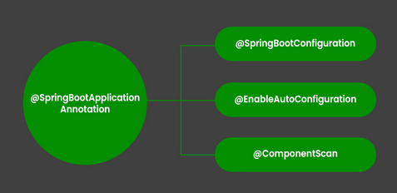
Spring Boot – Annotations
1. @SpringBootApplication-This annotation is used to mark the main class of a Spring Boot application. It encapsulates @SpringBootConfiguration, @EnableAutoConfiguration, and @ComponentScan annotations with their default attributes.

Slide 23
@SpringBootApplication
// Class
public class DemoApplication {
// Main driver method
public static void main(String[] args)
{
SpringApplication.run(DemoApplication.class, args);
}
}

Slide 24
2. @SpringBootConfiguration Annotation
It is a class-level annotation that is part of the Spring Boot framework. It implies that a class provides Spring Boot application configuration. It can be used as an alternative to Spring’s standard @Configuration annotation so that configuration can be found automatically. Most Spring Boot Applications use @SpringBootConfiguration via @SpringBootApplication. If an application uses @SpringBootApplication, it is already using @SpringBootConfiguration.

Slide 25
@SpringBootConfiguration
public class Application {
public static void main(String[] args) {
SpringApplication.run(Application.class, args);
}
@Bean
public StudentService studentService() {
return new StudentServiceImpl();
}
}

Slide 26
3. @EnableAutoConfiguration Annotation
This annotation auto-configures the beans that are present in the classpath. It simplifies the developer’s work by assuming the required beans from the classpath and configure it to run the application. This annotation is part of the spring boot framework. For example, when we illustrate the spring-boot-starter-web dependency in the classpath, Spring boot auto-configures Tomcat, and Spring MVC. The package of the class declaring the @EnableAutoConfiguration annotation is considered as the default. Therefore, we need to apply the @EnableAutoConfiguration annotation in the root package so that every sub-packages and class can be examined.

Slide 27
<dependency>
<groupId>org.springframework.boot</groupId>
<artifactId>spring-boot-starter-web</artifactId>
</dependency>

Slide 28
@Configuration
@EnableAutoConfiguration
public class Application {
public static void main(String[] args) {
SpringApplication.run(Application.class, args);
}
}

Slide 29
4. @ComponentScan Annotation
@ComponentScan tells Spring in which packages you have annotated classes that should be managed by Spring. So, for example, if you have a class annotated with @Controller which is in a package that is not scanned by Spring, you will not be able to use it as a Spring controller. So we can say @ComponentScan enables Spring to scan for things like configurations, controllers, services, and other components that are defined. Generally, @ComponentScan annotation is used with @Configuration annotation to specify the package for Spring to scan for components.

Slide 30
5.@Configuration
This annotation marks a class as a Configuration class for Java-based configuration.

Slide 31
a simple java bean class.
public class MyBean {
public MyBean() {
System.out.println("MyBean instance created");
}
}

Slide 32
add it’s dependencies to the maven project.
<dependency>
<groupId>org.springframework</groupId>
<artifactId>spring-context</artifactId>
<version>5.0.6.RELEASE</version>
</dependency>

Slide 33
Create Spring Configuration class
@Configuration
public class MyConfiguration {
@Bean
public MyBean myBean() {
return new MyBean();
}
}

Slide 34
write a simple class and configure our simple Spring configuration class
public class MySpringApp {
public static void main(String[] args) {
AnnotationConfigApplicationContext ctx = new AnnotationConfigApplicationContext();
ctx.register(MyConfiguration.class);
ctx.refresh();
// MyBean mb1 = ctx.getBean(MyBean.class);
// MyBean mb2 = ctx.getBean(MyBean.class);
ctx.close();
}
}

Slide 35
Note that Spring loads beans into it’s context before we have even requested it. This is to make sure all the beans are properly configured and application fail-fast if something goes wrong. Also ctx.refresh() must be called, otherwise we will get following error when we will try to get any bean from the context.

Slide 36
Note that MyBean is not calling the constructor of MyBean. It’s because the default scope of spring beans is Singleton. We can change it using @Scope annotation.

Slide 37
What if we remove @Configuration annotation?
What will happen if we remove the @Configuration annotation from MyConfiguration class. You will notice that it still works as expected and spring beans are registered and retrieved as singleton classes. But in this case, if we make a call to myBean() method then it will be a plain java method call and we will get a new instance of MyBean and it won’t remain singleton.

Slide 38
let’s define another bean that will be using MyBean instance
public class MyBeanConsumer {
public MyBeanConsumer(MyBean myBean) {
System.out.println("MyBeanConsumer created");
System.out.println("myBean hashcode = "+myBean.hashCode());
}
}

Slide 39
Our updated Spring Configuration class is:
//@Configuration
public class MyConfiguration {
@Bean
public MyBean myBean() {
return new MyBean();
}
@Bean
public MyBeanConsumer myBeanConsumer() {
return new MyBeanConsumer(myBean());
}
}

Slide 40
On running it you will see MyBean is not singleton anymore

Slide 41
So it’s better to use @Configuration annotation with configuration classes to make sure our spring container is behaving like the way we want it to. If you don’t want to use @Configuration annotation for some weird reasons, we can still create our configuration class by not calling the myBean() method and rather using an instance variable of MyBean configured through @Autowired annotation. Something like below code will work as well.

Slide 42
//@Configuration
public class MyConfiguration {
@Autowired
MyBean myBean;
@Bean
public MyBean myBean() {
return new MyBean();
}
@Bean
public MyBeanConsumer myBeanConsumer() {
return new MyBeanConsumer(myBean);
}
}

Slide 43
Creating a Rest Application with Spring Boot
What is a REST API?
REST stands for REpresentational State Transfer which is an architectural style which makes the effective use of http protocol.
Data transfer takes place mainly in two formats (JSON/XML).
JSON (Javascript Object Notation) follows the pattern of key:value pair whereas XML (eXtensible Markup Language) follows the root and branch (tags) pattern.

Slide 44
Every Application deals with data, it may be the User profile, User orders, Product information (for an e-commerce application) etc. So, there is a repository of data which needs to be handled effectively.
Applications need some input which can be processed to generate the output. The output needs to be returned to the client who requested for the data.
Web service is nothing but a service delivered over the web. REST helps in building web services which are called as RESTful web services. The below figure displays the JSON and XML structures respectively.

Slide 45
Development of REST API:
All the REST end-points will be scanned using the annotation @RestController.
It is required to mark your end-points with the type of request they can handle (GET, POST, DELETE, etc).

Slide 46
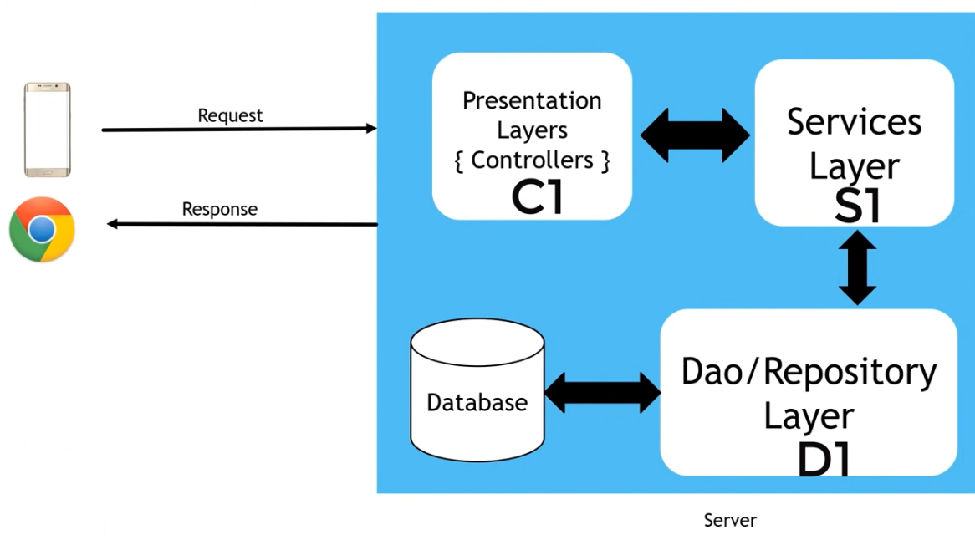

Slide 47
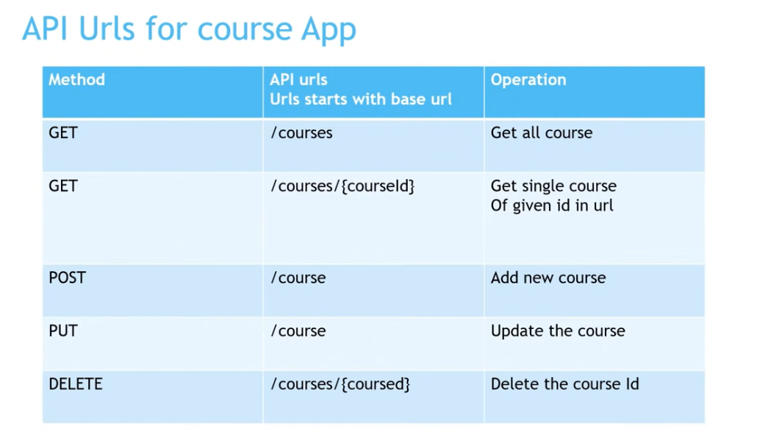

Slide 48
Spring MVC
It is a well-known and widely used framework for developing web applications with loosely coupled and well organised layering of presentation, persistence and controller layer. With a layered flexible architecture of Spring MVC, it becomes very convenient for developers to isolate the bricks and pieces and combine them together in the form of a professional web application. A web application developed following MVC standard is easier to scale, update and manage as a loosely coupled layered web application is much easier to modify to introduce any changes at a certain layer.

Slide 49
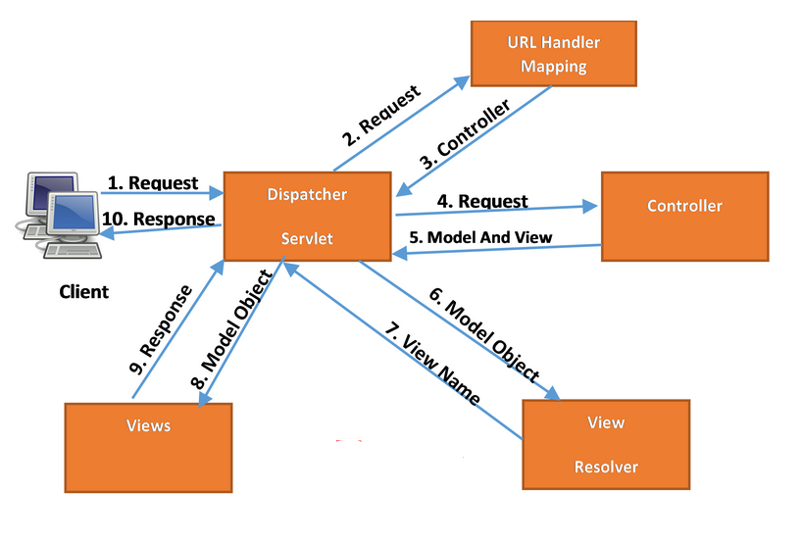
Spring MVC request flow is depicted in the diagram below:

Slide 50
Explanation of Spring MVC Request Flow
Client requests for a page by specifying the Web URL for the page.
Client request is intercepted by the Dispatcher Servlet also known as Front Controller. Dispatcher Servlet is a servlet specified in Web.XML file (for XML Based configurations) or in the Web Configuration class (for java based configurations).
Dispatcher Servlet uses URL Mapping Handler to find out the relevant controller class to which request should be passed for subsequent processing. For example, If you have a Controller defined for all requests by specifying “/” in the URL, all requests will be entertained by that controller.
Once Dispatcher Servlet has identified the Controller to be considered, it passes the client request to the controller.
The controller class is the main class controlling the business logic flow once request has been dispatched it it by dispatcher servlet. This class will implement the methods for different type of http requests (e.g. GET, POST) and all logic to call Service layer methods will reside in this controller class.

Slide 51
The controller class will also be responsible for returning the ModelAndView object back to the dispatcher servlet after getting all business logic executed and any data returned from DAO layer. ModelAndView object returned by the controller back to the controller specified both view and model objects.
Controller class is annotated by @Controller annotation.

Slide 52
After receiving ModelAndView object from the controller, Dispatcher Servlet now sends model object to view resolver to get the name of the view which needs to be rendered.
Once the view to be rendered has been identified, Dispatcher Servlet passes model object to the view. Model object contains the data which needs to be displayed in the view. View will be rendered with the model data. Views can be designed in any front-end technology.
This view is returned to the client and client can see the view and associated data on his browser.

Slide 53
Features
Clear separation of roles
Reusable business code, no need for duplication
Powerful and straightforward configuration of both framework and application classes as JavaBeans
Customizable binding and validation
Adaptability, non-intrusiveness, and flexibility

Slide 54
1. @Controller Annotation
This annotation serves as a specialization of @Component, allowing for implementation classes autodetected through classpath scanning.@Controller annotation tells the Spring IOC container to treat this class as Spring MVC controller.

Slide 55
@Controller
public class SpringMVCController {
//HTTP Mappings
}

Slide 56
2. @RestController Annotation
A convenience annotation that is itself annotated with @Controller and @ResponseBody.
@RestController
public class FilterExampleController {
@GetMapping
public String greeting() {
return "Hello World";
}
@GetMapping(value = "/greeting")
public String customGreetings() {
return "Hello From Custom Greetings";
}
}

Slide 57
3. @RequestMapping
Annotation for mapping web requests methods in the Spring MVC Controller. Both Spring MVC and Spring WebFlux support this annotation.@RequestMapping annotation provides several options to customize its behavior.
Consumes – The consumable media types of the mapped request, narrowing the primary mapping. (e.g. @RequestMapping(value = {"application/json", "application/xml"})).
method – The HTTP request methods to map (e.g. method = {RequestMethod.GET,RequestMethod.POST}).
header – The headers of the mapped request.
name – the name of the mapping.
value – The primary mapping expressed by this annotation
produces – The producible media types of the mapped request.

Slide 58
@Controller
public class SpringMVCController {
@RequestMapping(value = {
"/greetings",
"/hello-world"}, method = {RequestMethod.GET,RequestMethod.POST},
consumes = {"application/json","application/xml"},
produces = { "application/json"},headers = {"application/json"
})
public String hellpWorld() {
return "Hello";
}
}

Slide 59
Note: This annotation can be used both at the class and at the method level
@Controller
@RequestMapping(value = {
"/greetings"
}, method = {
RequestMethod.GET
})
public class SpringMVCController {}

Slide 60
With newly composed annotation, it’s easier and more readable.
@GetMapping(value = "/new-mapping")
public String newMapping(){
return "hello";
}

Slide 61
Here is the list of new @RequestMapping annotations introduced in Spring 4.3
@GetMapping
@PostMapping
@PutMapping
@DeleteMapping
@PatchMapping

Slide 62
What is PATCH?
Unlike PUT, PATCH applies a partial update to the resource.
This means that you are only required to send the data that you want to update, and it won’t affect or change anything else. For example, if you want to update the first name of the user in the database, you will only be required to send the first name parameter in the HTTP request.

Slide 63
For example, consider we want to update the User resources partially (only emailId field) in a database. So here is the REST API that demonstrates the usage of @PatchMapping annotation:

Slide 64
@PatchMapping("/users/{id}")
public ResponseEntity<User> updateUserPartially(
@PathVariable(value = "id") Long userId,
@Valid @RequestBody User userDetails) throws ResourceNotFoundException {
User user = userRepository.findById(userId)
.orElseThrow(() -> new ResourceNotFoundException("User not found on :: "+ userId));
user.setEmailId(userDetails.getEmailId());
user.setUpdatedAt(new Date());
final User updatedUser = userRepository.save(user);
return ResponseEntity.ok(updatedUser);
}

Slide 65
4. @RequestParam
Annotation which shows that it binds a method parameter to a web request parameter. Request parameters passed by the browser/client as part of the HTTP request, the @RequestParam annotation help to map these parameters easily at the controller level.
@GetMapping("/request-mapping-example")
public String requestMappingExample(@RequestParam("code") String code) {
//
}

Slide 66
*Note With @RequestParam we can specify default value when Spring finds no or empty value in the request.
public String requestMappingExample(@RequestParam(defaultValue = "1") long productQty){}

Slide 67
5. @PathVariable
This annotation shows that a method parameter bound to a URI template variable. We specify the variable as part of the @RequestMapping and bind a method argument with @PathVariable. Let’s take an example where we want to pass productCode as part of the URI and not request parameter.
@GetMapping("/products/{id}")
public String getProduct(@PathVariable("id") String sid) {
//
}

Slide 68
Note-
The variable name in the @PathVariable annotation is optional if the name of the part in the template matches the name of the method argument. For the above example, we can omit “id” from the @PathVariable annotation.
@GetMapping("/products/{id}")
public String getProduct(@PathVariable String id) {
//
}

Slide 69
Use “require” parameter to mark the path variable as an optional.
@GetMapping("/products/{id}")
public String getProduct(@PathVariable(required = false) String id) {
//
}

Slide 70
6. @SessionAttribute
Annotation to bind a method parameter to a session attribute.@SessionAttribute used to pass value across different requests through the session. Rather than using HttpSession object directly, using this annotation can benefit auto type conversion and optional/required check.

Slide 71
@GetMapping("/user")
public String sessionexample(@SessionAttribute(name = "userLoginTime") LocalDateTime startDateTime) {
//
}

Slide 72
7. @RequestBody
The @RequestBody annotation showing a method parameter bound to the body of the web request. It passes the body of the request through an HttpMessageConverter to resolve the method argument depending on the content the request.
@PostMapping("/product/save") public String saveProduct(@RequestBody Product product){}

Slide 73
8. @ResponseBody
The @ResponseBody Annotation that shows a method return value bound to the web response body. Supported for annotated handler methods. Spring treats the result of the method as the response itself.
@GetMapping("/products/{id}")
public @ResponseBody Product saveProduct(@PathVariable("id") String id) {
//
}

Slide 74
9. @ExceptionHandler
ExceptionHandler is a Spring annotation handle exceptions thrown by request handling. This annotation works at the @Controller level.

Slide 75
@GetMapping("/greeting")
String greeting() throws Exception {
//
}
@ExceptionHandler({
Exception.class
})
public handleException() {
//
}

Slide 76
11. @ModelAttribute
@ModelAttribute refers to a property of the Model object in Spring MVC. This ModelAttribute annotation binds a method parameter or method return value to a named model attribute, exposed to a web view.
@PostMapping("/customer-registration")
public String processForm(@ModelAttribute("customer") Customer customer) {}

Slide 77
Why @Qualifier
@Service("userServiceImpl")
public class UserServiceImpl implements UserService {
@Override
public void enableUser() { }
}
@Service("defaultUserService")
public class DefaultUserService implements UserService {
@Override
public void enableUser() {}
}
public class OrderFacade {
@Autowired
private UserService userService;
}

Slide 78
The above code will give you error

Slide 79
Need to use @qualifier to make use of the above code, because now autowire will be able to identify which bean to inject.
public class OrderFacade {
@Qualifier("userServiceImpl")
@Autowired
private UserService userService;
}

Slide 80
12. @Qualifier Annotation
The @Qualifier annotation helps disambiguate bean references when Spring otherwise could not do so. In our case, to we can use the @Qualifier annotation help in the issue to choose the correct bean for the dependency injection.

Slide 81
public class OrderFacade {
@Qualifier("userServiceImpl")
@Autowired
private UserService userService;
}

Slide 82
13. @CrossOrigin
This annotation allows the cross-domain communication for the annotated handler methods. This @CrossOrigin annotation enables cross-origin resource sharing only for this specific method. Let’s take an example where we want to allow only <a class="bare" href="http://localhost:9000">http://localhost:9002</a> to send cross-origin requests.

Slide 83
@CrossOrigin(origins = "http://external-system.com", maxAge = 3600)
@RestController
@RequestMapping("/products")
public class AccountController {
@GetMapping("/{code}")
public Product getProduct(@PathVariable String code) {
// ...
}
@GetMapping("/reviews")
public List<ProductReviews> getProductReviews() {
// ...
}
}

Slide 84
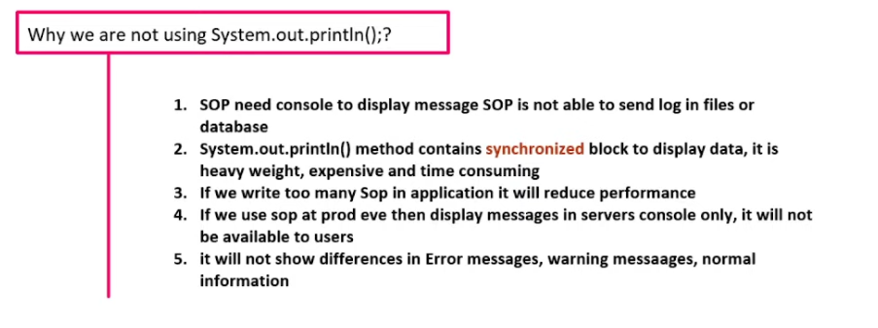

Slide 85
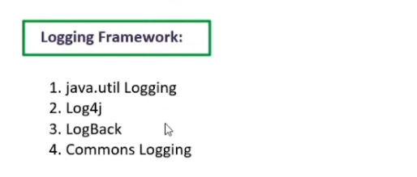

Slide 86
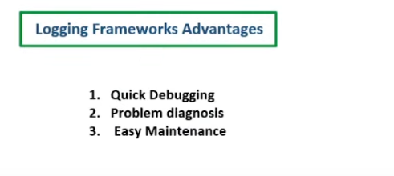

Slide 87
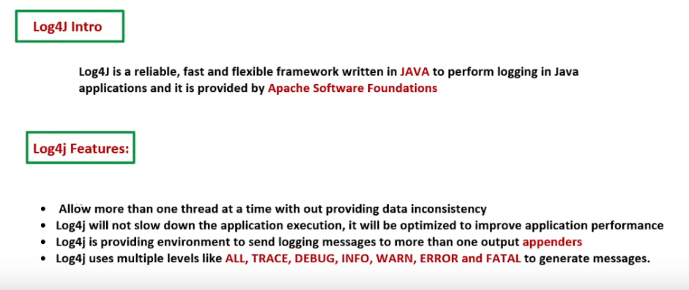

Slide 88
Add dependency:
<dependencies>
<dependency>
<groupId>org.apache.logging.log4j</groupId>
<artifactId>log4j-api</artifactId>
<version>2.13.0</version>
</dependency>
<dependency>
<groupId>org.apache.logging.log4j</groupId>
<artifactId>log4j-core</artifactId>
<version>2.13.0</version>
</dependency>
</dependencies>

Slide 89
log2j2.properties
//name=PropertiesConfig
property.filename = logs
appenders = console, file
appender.console.type = Console
appender.console.name = STDOUT
appender.console.layout.type = PatternLayout
appender.console.layout.pattern = [%-5level] %d{yyyy-MM-dd HH:mm:ss.SSS} [%t] %c{1} - %msg%n
appender.file.type = File
appender.file.name = LOGFILE
appender.file.fileName=${filename}/propertieslogs.log
appender.file.layout.type=PatternLayout
appender.file.layout.pattern=[%-5level] %d{yyyy-MM-dd HH:mm:ss.SSS} [%t] %c{1} - %msg%n
loggers=file
logger.file.name=log4j2properties
logger.file.level = debug
logger.file.appenderRefs = file
logger.file.appenderRef.file.ref = LOGFILE
rootLogger.level = debug
rootLogger.appenderRefs = stdout
rootLogger.appenderRef.stdout.ref = STDOUT

Slide 90
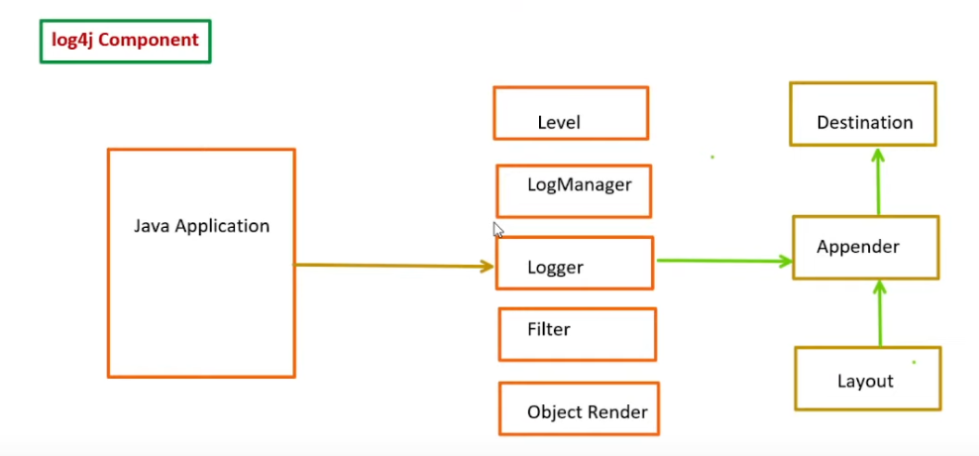

Slide 91
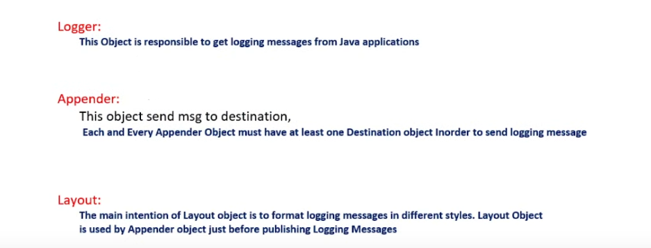

Slide 92
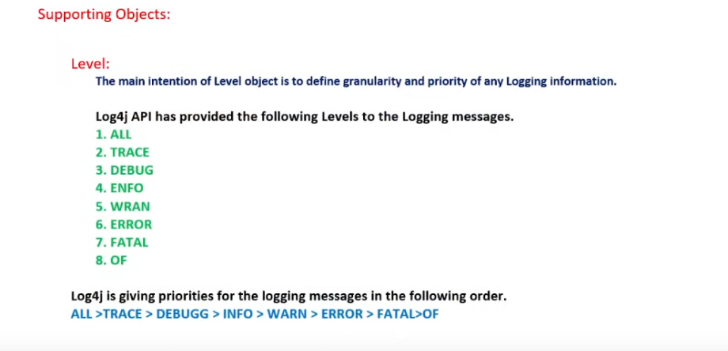

Slide 93
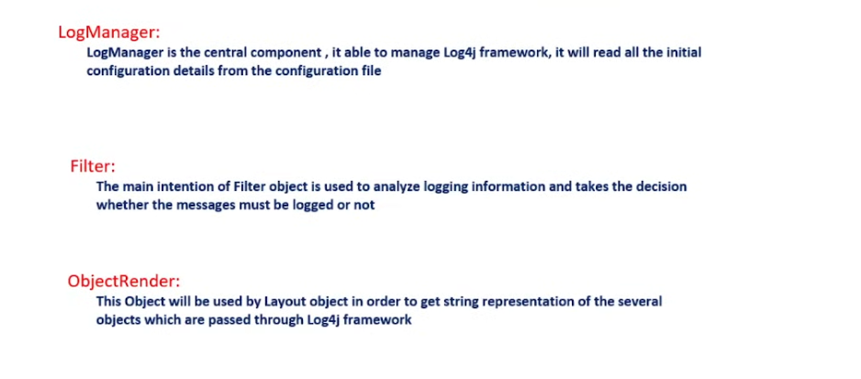

Slide 94
Spring Data JPA
We can use Spring Data JPA to reduce the amount of boilerplate code required to implement the data access object (DAO) layer.
Spring Data JPA is not a JPA provider. It is a library/framework that adds an extra layer of abstraction on top of our JPA provider (like Hibernate).

Slide 95
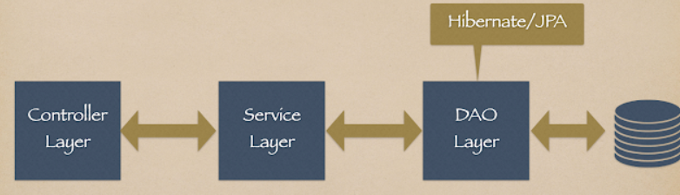

Slide 96
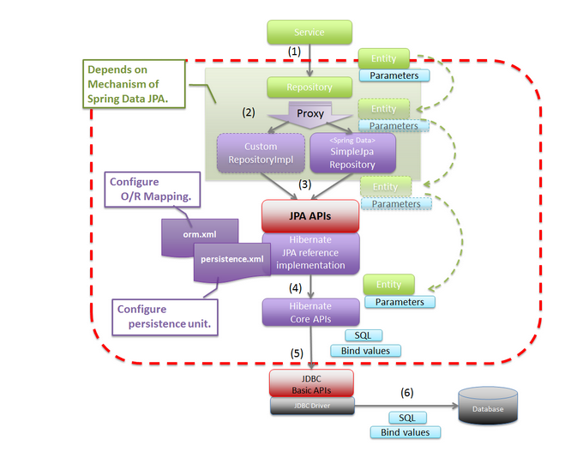

Slide 97
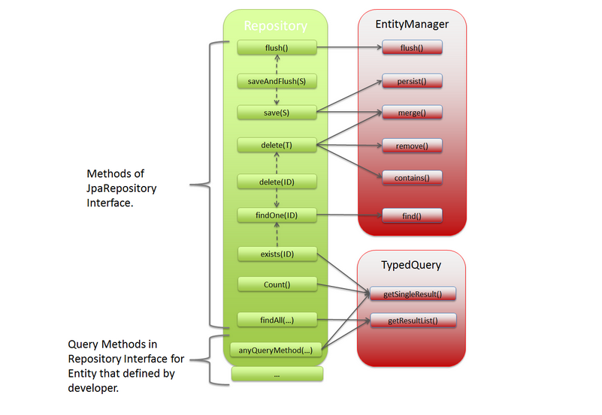

Slide 98
<dependency>
<groupId>org.springframework.boot</groupId>
<artifactId>spring-boot-starter-data-jpa</artifactId>
</dependency>

Slide 99
To add Database Dependency-
our Spring Boot JPA to work with database correctly, we need to add dependency to a database specific JDBC driver. We are using MySQL for this post. This is how the DB drover dependency will look like.
<dependency>
<groupId>mysql</groupId>
<artifactId>mysql-connector-java</artifactId>
<scope>runtime</scope>
</dependency>

Slide 100
2. Configuration
server.port=8082
#db configuration
spring.datasource.url=jdbc:mysql://localhost:3345/new_course
spring.datasource.username=root
spring.datasource.password=12345
spring.datasource.driver-class-name=com.mysql.cj.jdbc.Driver
spring.jpa.properties.hibernate.dialect=org.hibernate.dialect.MySQL8Dialect
#create,update,create-drop,validate
spring.jpa.hibernate.ddl-auto=update

Slide 101
#only for the local/ dev server to show the SQL queries on console.
spring.jpa.show-sql=true

Slide 102
Create a repository interface and extend it to the JpaRepository interface
import java.util.List;
import net.javaguides.springdatajpacourse.entity.Product;
import org.springframework.data.jpa.repository.JpaRepository;
@Repository
public interface ProductRepository extends JpaRepository<Product, Long> {
}

Slide 103
We can add custom query methods to the created repository interface (if we need them)
import com.springboot.crud.example.entity.Product;
import org.springframework.data.jpa.repository.JpaRepository;
public interface ProductRepository extends JpaRepository<Product,Integer> {
Product findByName(String name);
}
Spring Data JPA query methods are the most powerful methods, we can create query methods to select the records from the database without writing SQL queries. Behind the scenes, Spring Data JPA will create SQL queries based on the query method and execute the query for us.

Slide 104
Inject the repository interface to another component and use the implementation that is provided automatically by Spring Data JPA
Note-We have to annotate our entity class with @Entity then only table will be created in your database

Slide 105
JPA Annotations for mapping java object to database table
1.@Table: It specifies the table in the database with which this entity is mapped. In the example below the data will be stores in the “employee” table. Name attribute of @Table annotation is used to specify the table name.
@Entity
@Table(name = "employee")
public class Employee implements Serializable {
}

Slide 106
2. @Column: Specify the column mapping using @Column annotation. Name attribute of this annotation is used for specifying the table’s column name.
@Entity
@Table(name = "employee")
public class Employee implements Serializable {
@Column(name = "employee_name")
private String employeeName;
}

Slide 107
3. @Id: This annotation specifies the primary key of the entity.
@Entity
@Table(name = "employee")
public class Employee implements Serializable {
@Id
@Column(name = "id")
private int id;
}

Slide 108
4. @GeneratedValue: This annotation specifies the generation strategies for the values of primary keys.
@Entity
@Table(name = "employee")
public class Employee implements Serializable {
@Id
@Column(name = "id")
@GeneratedValue(strategy=SEQUENCE, generator="ID_SEQ")
private int id;
}

Slide 109
5. @OrderBy: Sort your data using @OrderBy annotation. In example below, it will sort all employees_address by their id in ascending order.
@OrderBy("id asc")
private Set employee_address;

Slide 110
6. @Transient: Every non static and non-transient property of an entity is considered persistent, unless you annotate it as @Transient.
@Transient
Private int employeePhone;

Slide 111
7. @Lob: Large objects are declared with @Lob.
@Lob
public String getEmployeeAddress() {
return employeeAddress;
}

Slide 112
Hibernate Annotations for Mapping between tables
We have another set of annotations that are used to specify the association mapping between different tables and entities.

Slide 113
Example-
Tables ‘employee’ and ‘employeeDetail’ have one-to-one association and they share the same primary key.
Tables ‘communication’ and ‘communicationDetail’ are linked by a foreign key. It is also a one to one association.
Tables ‘communication’ and ‘employee’ are linked using a foreign key in many-to-one association with communication being the owner.
Tables ‘employee’ and ‘employeeStatus’ are linked through a foreign key in many-to-one association with employee being the owner.

Slide 114
@Entity
@Table(name = "employee")
public class Employee implements Serializable {
@Id
@Column(name = "id")
@GeneratedValue
private int id;
@OneToOne(cascade = CascadeType.MERGE)
@PrimaryKeyJoinColumn
private EmployeeDetail employeeDetail;
}
@Entity
@Table(name = "employeeDetail")
public class EmployeeDetail implements Serializable {
@Id
@Column(name = "id")
private int id;
}

Slide 115
@OneToOne Employee and EmployeeDetail entities share the same primary key and we can associate them using @OneToOne and @PrimaryKeyJoinColumn. In this case the id property of EmployeeDetail is not annotated with @GeneratedValue. The id value of Employee will be used for used for id of EmployeeDetail.

Slide 116
Points to note:
@PrimaryKeyJoinColumn should be used for associated entities sharing the same primary key.
@JoinColumn & @OneToOne should be mappedBy attribute when foreign key is held by one of the entities.

Slide 117
@Entity
@Table(name = "communicationDetail")
public class CommunicationDetail implements Serializable {
@Id
@Column(name = "id")
@GeneratedValue
private int id;
@OneToOne
@MapsId
@JoinColumn(name = "communicationId")
private Communication communication;
}
@Entity
@Table(name = "communication")
public class Communication implements Serializable {
@Id
@Column(name = "ID")
@GeneratedValue
private Integer id;
@OneToOne(mappedBy = "communication", cascade = CascadeType.ALL)
private CommunicationDetail communicationDetail;
}

Slide 118
Communication and CommunicationDetail are linked through a foreign key, so @OneToOne and @JoinColumn annotations can be used.The id genereated for Communication will be mapped to ‘communication_id’ column of CommunicationDetail table. @MapsId is used for the same.

Slide 119
@Entity
@Table(name = "employee")
public class Employee implements Serializable {
@ManyToOne
@JoinColumn(name = "statusId")
private EmployeeStatus status;
}

Slide 120
@ManyToOne Many employees can share the same status. So, employee to employeeStatus is a many to one relation. @ManyToOne annotation can be used for the same.

Slide 121
@Entity
@Table(name = "employee")
public class Employee implements Serializable {
@OneToMany(mappedBy = "employee", fetch = FetchType.EAGER)
@OrderBy("firstName asc")
private Set communications;
}

Slide 122
@OneToMany Employee to Communication will be a one-to-many relationship. The owner of this relationship is Communication so, we will use ‘mappedBy’ attribute in Employee to make it bi-directional relationship.

Slide 123
What is Fetch Type?
The fetch type essentially decides whether or not to load all of the relationships of a particular object/table as soon as the object/table is initially fetched.
The FetchType.EAGER tells Hibernate to get all elements of a relationship when selecting the root entity.
The FetchType.LAZY tells Hibernate to only fetch the related entities from the database when you use the relationship. This is a good idea in general because there’s no reason to select entities you don’t need for your uses case.

Slide 124
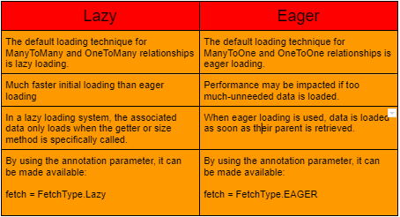

Slide 125
@Entity
@Table(name = "employee")
public class Employee implements Serializable {
@Id
@Column(name = "id")
@GeneratedValue
private int id;
@OneToOne(cascade = CascadeType.MERGE)
@PrimaryKeyJoinColumn
private EmployeeDetail employeeDetail;
}

Slide 126
@PrimaryKeyJoinColumn This annotation is used to associate entities sharing the same primary key.

Slide 127
@ManyToOne
@JoinColumn(name = "statusId")
private EmployeeStatus status;

Slide 128
@JoinColumn @JoinColumn annotation is used for one-to-one or many-to-one associations when foreign key is held by one of the entities.

